Slide 1





ONLINE EXAMINATION SYSTEM
Team Members:
GUNDLOORU NAVAZ
SAKIBANDA CHANDANA
KEERTHIPATI POOJITHA Guide: UMA MAHESWARI R
SANGANI CHANDU

Slide 2
OUTLINE
Abstract
Problem Statement
Aims, Objective & Proposed System/Solution
System Design/Architecture
System Development Approach (Technology Used)
Algorithm & Deployment
Conclusion
Future Scope
References
Video of the Project
Notes:
These are the list of chapters that we are going to cover in these foundation codes. Those are chapter one what are AI and ML? chapter 2 applied Python programming in AI, and chapter 3 is exploratory data analysis for ML.

Slide 3
Abstract
In the realm of online education, the focus on creating effective assessment questions and streamlining exam feedback delivery is paramount.
This project addresses the need for enhancement in online examination processes, particularly emphasizing techniques relevant to:
Answer submission
Computerized grading
Post-submission feedback mechanisms
As contemporary organizations increasingly rely on automation, the coordination between human resources, commodities, and computers becomes indispensable.
Through this project, administrators, instructors, and students engage with the system, facilitating the seamless implementation and monitoring of online examination activities.
Key functionalities include conducting exams according to predefined schedules and promptly delivering results to individual students.
Moreover, the system maintains detailed records of students who participate in online examinations, ensuring efficient administration and data management.

Slide 4
Problem Statement
Regular exams often pose challenges in managing papers, ensuring security, and maintaining smooth operations. This project addresses these issues by developing an Online Examination System tailored to meet the needs of educational institutions. The primary objective is to create a system that simplifies the exam process, enhances security measures, and improves overall efficiency. By providing schools and colleges with a user-friendly platform for exam creation, management, and result handling, the system streamlines exam administration and reduces administrative burdens. Moreover, it offers flexible exam scheduling options, upholds academic integrity through advanced security features, and provides instant feedback and performance analytics to students and instructors. With compatibility for remote learning environments and seamless integration with existing Learning Management Systems (LMS), the system adapts to the evolving needs of educational institutions. Its scalability and adaptability ensure that it can accommodate varying user requirements and exam formats over time. In essence, the Online Examination System revolutionizes traditional exam methods, offering a comprehensive solution to the challenges faced by educational institutions in the digital age.

Slide 5
Aim and Objective
Aim:
The aim of this project is to explore and improve the assessment process in online examinations by examining techniques related to answer submission, computerized grading, and post-submission feedback delivery.
Objective:
The objective of this project is to identify and analyze techniques that enhance the efficiency and effectiveness of online examination assessments, focusing on three key components:
Answer submission methods
Computerized grading systems
Post-submission feedback mechanisms
By outlining specific strategies and approaches within each component, the project aims to offer actionable insights for optimizing the online examination experience for both instructors and students.

Slide 6
Proposed Solution
The proposed system is an online examination application designed to address the limitations of the existing manual process. Students can access the application from individual terminals and log in to take exams within the specified duration. Questions are provided to students electronically, and the application automatically corrects exams, displays results instantly, and stores them in a database.
The application also provides administrators with the ability to add new exams, while instructors can add or modify questions for specific exams. Additionally, the system ensures authentication for administrators, instructors, and students, enhancing security and access control. The proposed system aims to streamline the examination process, reduce administrative burdens, and improve overall efficiency in managing exams and results.

Slide 7
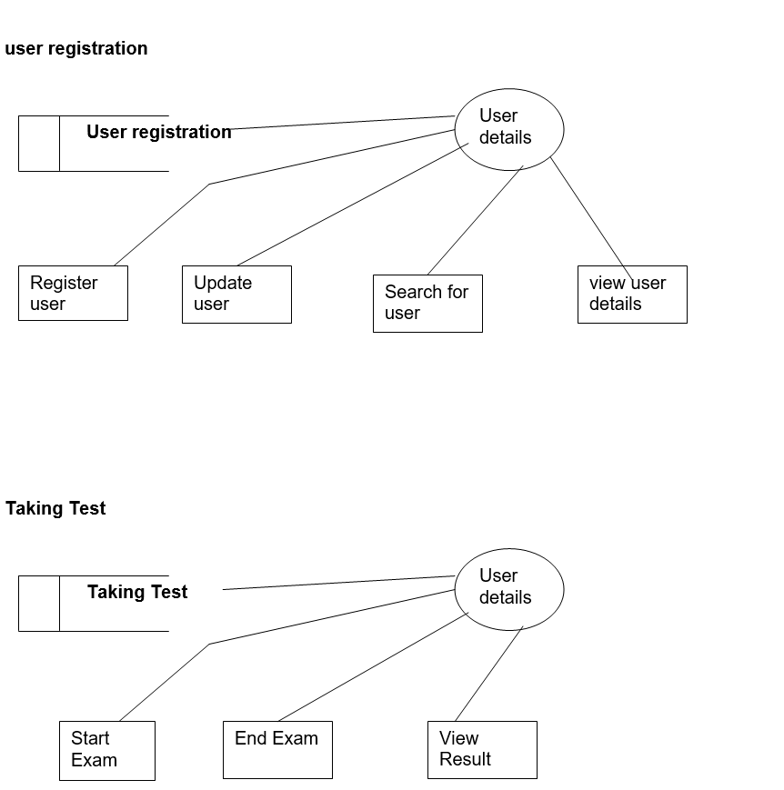
System Architecture

Slide 8
Algorithm & Deployment
Algorithm: Authenticate Admin User
Input:
- $_POST[‘u name']: User's email or username
- $_POST['password']: User's password
- $ref: The referring page URL
Output: Redirect to dashboard or back to referring page with appropriate message
1. Include the database connection script ‘db Connection. php'.
2. Retrieve user input:
- Get the value of ‘u name' (username/email) from the HTTP POST request.
- Get the value of 'password' from the HTTP POST request.
3. Sanitize user input:
- Remove any potentially harmful characters from ‘u name' and 'password' to prevent SQL injection attacks.

Slide 9
4. Execute a database query:
- Perform a SQL SELECT query to check if there is a record in the 'admin' table where the email and password match the provided values.
5. Process the query result:
a. If the query returns exactly one matching record:
- Start a session.
- Set session variables:
- $_SESSION["name"] = 'Admin'
- $_SESSION["key"] = 'Navaz2002'
- $_SESSION["email"] = $email
- Redirect the user to the dashboard page 'dash.php?q=0' with a success message.
b. If no matching record is found:
- Redirect the user back to the referring page '$ref' with a warning message.
End Algorithm

Slide 10
Deployment Steps:
Set Up the Database:
Create a MySQL database with a table named admin containing fields like email and password.
Populate the table with admin user data.
Create dbConnection.php:
Create a PHP script (dbConnection.php) responsible for establishing a connection to the MySQL database. Make sure to handle errors gracefully.
Deploy PHP Script:
Place the PHP script containing the provided code on your web server. Ensure it is accessible via the appropriate URL.
Configure Server Environment:
Ensure that your server environment supports PHP and MySQL. Install necessary extensions if required.
Secure Database Credentials:
Store sensitive database credentials securely, preferably outside the web root directory, to prevent unauthorized access.
Test the Application:
Test the login functionality thoroughly to ensure it works as expected.
Check for any security vulnerabilities, such as SQL injection or session fixation attacks.
Monitor and Maintain:
Regularly monitor your application for errors and security vulnerabilities.
Keep your server software, including PHP and MySQL, up to date with the latest patches and updates.

Slide 11
System deployment approach
Hardware Requirements:
Pentium-IV Processor
256 MB RAM
512 KB Cache Memory
10 GB Hard Disk
Microsoft Compatible Keyboard (101 keys or more)
Software Requirements:
Operating System: Windows
Web Technology: PHP
Front-End: HTML, CSS, JavaScript
Back-End: PHP, MySQL
Web Server: Apache Server

Slide 12
Conclusion
The package was designed to facilitate easy future modifications.
Automation improves system efficiency.
User-friendly interface enhances usability.
Access control ensures appropriate permissions.
Overcomes delays in communication.
Information updating simplified.
System security, data security, and reliability are key features.
Adequate scope for future modifications.

Slide 13
Future Scope
This application avoids manual work and associated problems.
Future Enhancements:
Enhanced User Experience
Adding quiz directly in admin page
Integration with Learning Management Systems (LMS)
Enhanced Security Features
Intelligent Automation
The enhancement that we can add the searching option. We can directly search to the particular student details from this site.

Slide 14
Reference
https://www.researchgate.net/publication/317306939_Online_Examination_System
GitHub Link:
https://github.com/NAVAZ24/Online-Examination-System
Video Demo Link:
https://drive.google.com/file/d/12d-pyMt97vOwTL7xyp8k5ur7DAd84jwa/view?usp=sharing
Notes:
Reference
These are the references for this session.
14

Slide 15
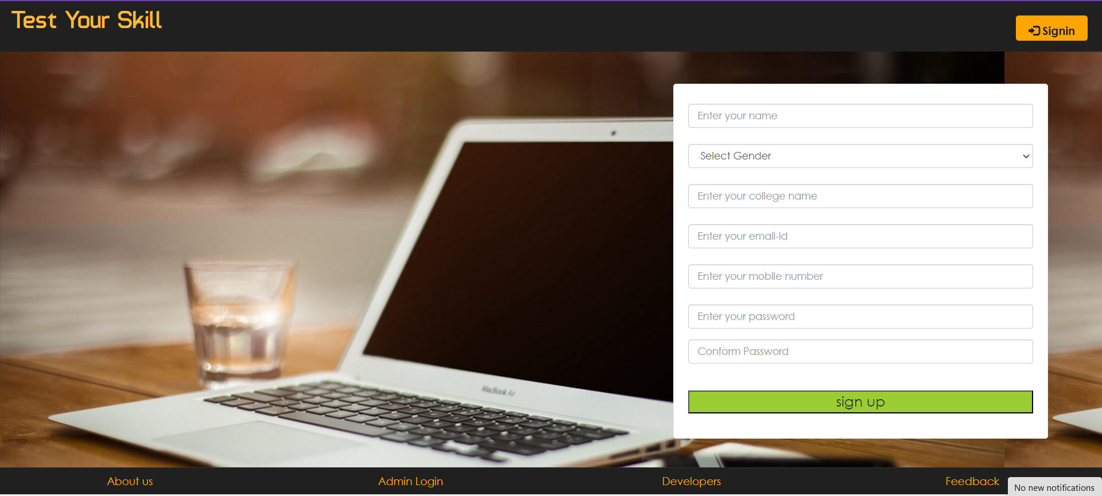
Output:

Slide 16
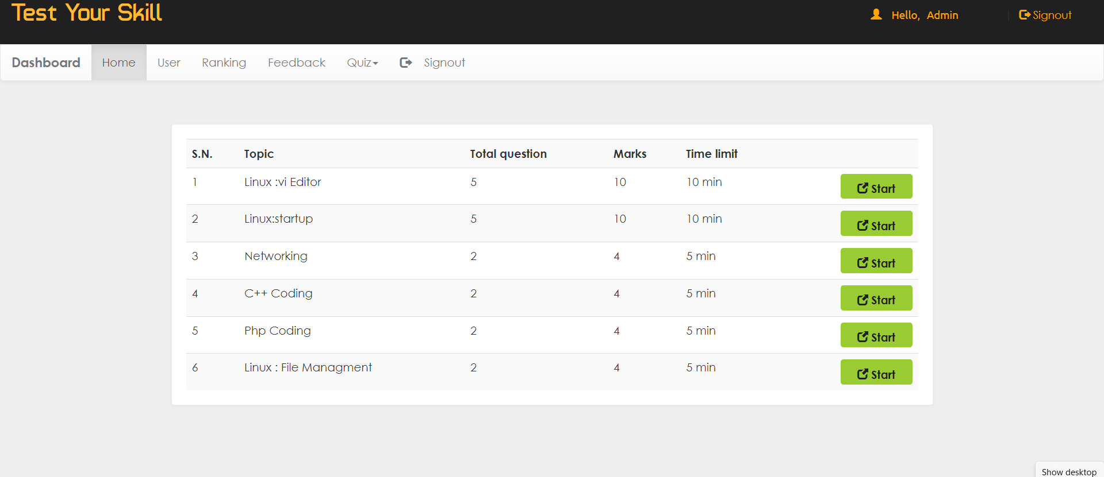

Slide 17
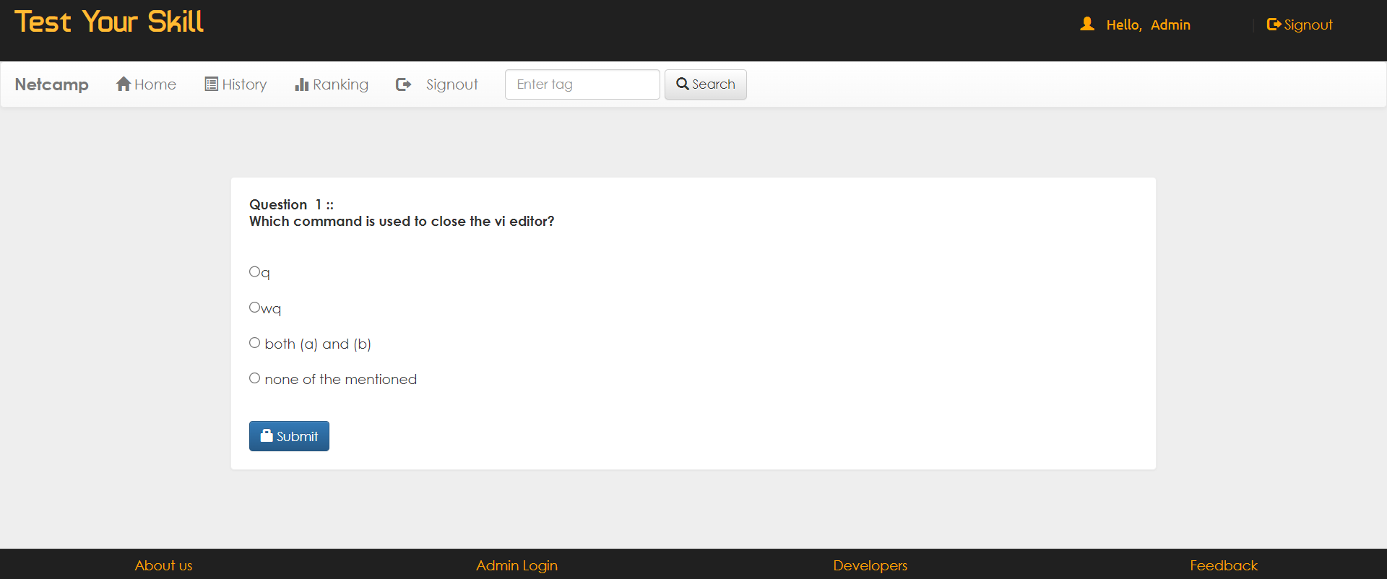

Slide 18

Notes:
thank you very much for joining this PPT, keep learning.
18

